Slide 1

Exercise 4: Web Chat

Slide 2
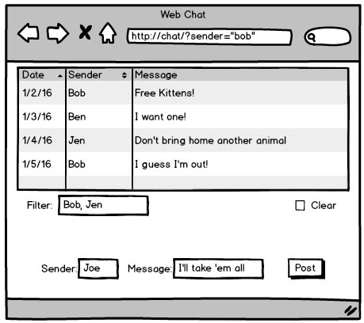
Exercise 4: Web Chat
Create a web interface for your CorkBoardImpl server from module 2.
The user should be able to:
See the list of messages
Post a new message to the board
Ask the server to filter the messages by a list of names
Clear the board
Be as creative as you like, but you only need one servlet that generates one page with one form and one button.

Slide 3
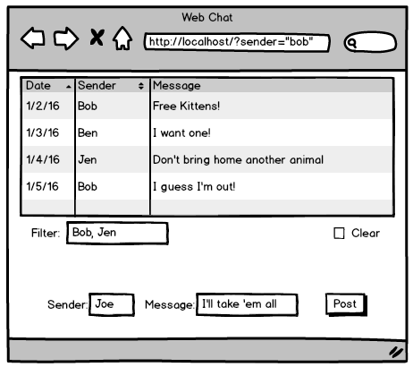
Exercise 4
URL parameters
GET does everything
Doesn’t have to be a table. A list is fine.
List of names separated by comma. Server filters return messages by names.
If checked the server will clear the messages when the form is submitted.
If sender and message are blank then the list is just refreshed.
Send command to the server. Get back this same form and new list of messages

Slide 4
Hints
Here are some hints and ideas to get you started.
Start with the servlet:
What parameters are you going to take in the URL?
Stub it out by returning a simple “OK”.
Use the browser to send requests. Put your test parameters in the URL.
Extract and print the parameters in your servlet code.

Slide 5
Hints
Add in the CorkBoardImpl:
Copy your CorkBoard code into your new project.
You can just use the Impl code (no RMI needed).
Implement the servlet code to talk to the CorkBoard object
Print the responses from the CorkBoard object with println statements.
Still return a simple “OK” at this point.
Use the browser to test the code.

Slide 6
Hints
Experiment with a static HTML file:
Add a list (or table) of example messages.
Add the form and fields.
Press the send button and check the parameters in the URL line.
Use the form to test your servlet.

Slide 7
Hints
Flesh out the Servlet:
Add print statements to your servlet to return the full HTML.
Copy lines from the static HTML page you just created.
Test, test, test! Try multiple browser windows. Have a nice chat with yourself!

